Slide 1
K Nearest Neighbor Classification (KNN)
Guided by Dr.Liu
GCIS_523_0A Statistical Computing
By
Mashfi Alshammari
and
Tarun Mirani

Slide 2
K Nearest Neighbors - Classification
K nearest neighbors is a simple algorithm that stores all available cases and classifies new cases based on a similarity measure.

Slide 3
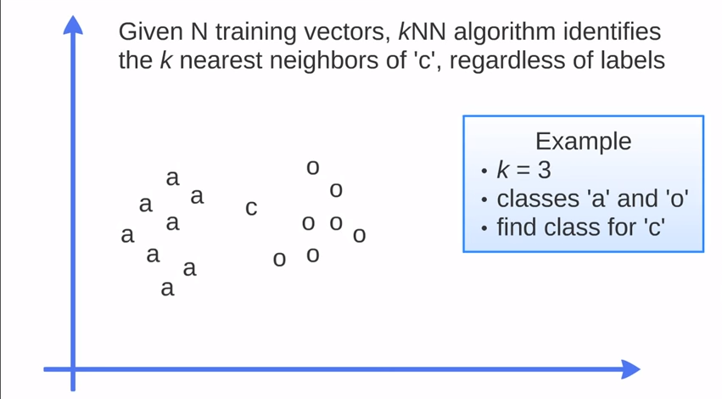
How KNN algorithm works ?
https://www.youtube.com/watch?v=UqYde-LULfs

Slide 4
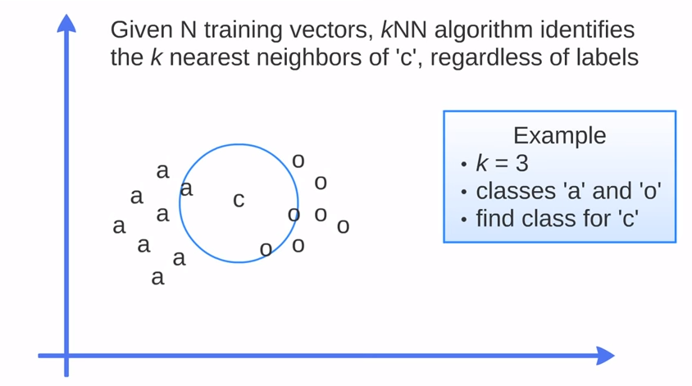
https://www.youtube.com/watch?v=UqYde-LULfs

Slide 5
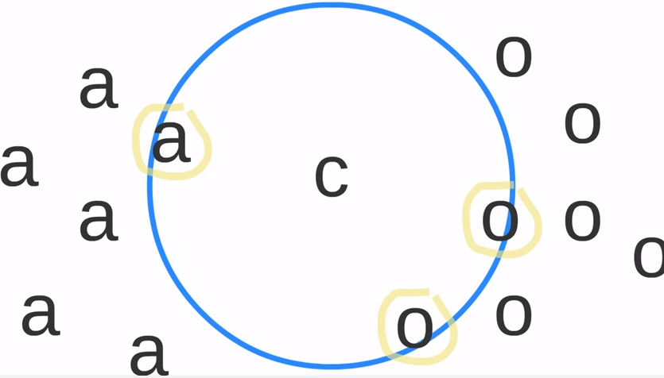
https://www.youtube.com/watch?v=UqYde-LULfs

Slide 6
IRIS
Iris data set gives the measurements in centimeters of the variables sepal length and width and petal length and width, respectively,
For 50 flowers from each of 3 species of iris. The species are Iris setosa, versicolor, and virginica

Slide 7
References
http://www.saedsayad.com/k_nearest_neighbors.htm
https://www.youtube.com/watch?v=UqYde-LULfs
https://stat.ethz.ch/R-manual/R-devel/library/datasets/html/iris.html

